Slide 1





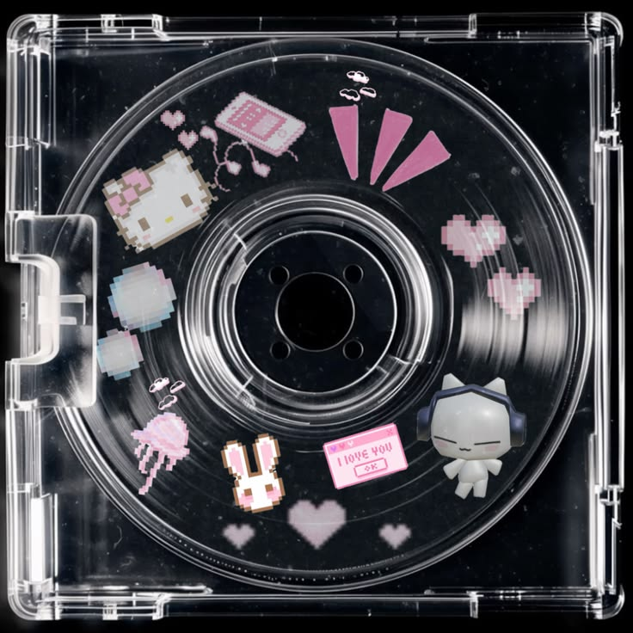
Capstone Lightning Talk #2: Spotify Mood
Clustering
jayjay’s Playlists
Search
Home
Library
Gana Elansary
DSB-2

Slide 2

Table of contents
01
02
03
04
Problem
Data & EDA
Why genre can’t predict mood
Audio features, cleaning, and what the data shows
Modeling
Live Demo
K-Means vs. DBSCAN vs. Agglomerative
Single-track prediction, radar chart, playlist

Slide 3




The Problem
Why can’t we just use genre as “mood”?
Because genre is a weak proxy:
A single genre spans calm and intense tracks alike
The real mood signal lives in the audio features, not the genre tag
So clustering has to run on audio features alone — unsupervised
Success = statistically separated AND interpretable clusters, validated on real tracks

Slide 4
Potential Audience
Listeners
Wants to match songs to a mood
Dev Teams
Builds mood discovery features
Analysts
Tracks mood trends in a library

Slide 5
Goals & Objectives
Type
Method
Unsupervised clustering — no target variable
Models
Count
K-Means · DBSCAN · Agglomerative Clustering
Metrics
Checks
Silhouette, Davies-Bouldin, Elbow, real-track checks

Slide 6
Mood-DNA Feature Dictionary
7 features
# | Feature |  | Range | Role | Notes
1 |  | energy | 0.0–1.0 | Core axis | Intensity
2 |  | valence | 0.0–1.0 | Core axis | Happy vs. sad
3 |  | danceability | 0.0–1.0 | Texture | Rhythm
4 |  | acousticness | 0.0–1.0 | Texture | Acoustic
5 |  | loudness | -46 to +1 dB | Intensity | Scale first
6 |  | tempo | 0-239 BPM | Intensity | Scale first
7 |  | mode | 0 or 1 | Weak signal | Major/minor

Slide 7

Data Readiness
What does the data need before clustering?
Three things stood out:
loudness and tempo sit on totally different scales than the 0-1 features
energy and loudness correlate at ~0.68 the strongest pair
Real outliers found in acousticness, loudness, and tempo
So every feature is scaled with RobustScaler first

Slide 8
Genre ≠ Mood
Spotify Mood Clustering
Search
Home
Library

Slide 9
What We Found
Does genre actually predict mood?
The evidence says no:
Valence & energy boxplots span a wide range inside every genre
A valence-vs-energy scatter shows genres overlapping almost completely
No genre owns a distinct region of the mood plane
Conclusion: mood must be learned from audio features, not inherited from genre

Slide 10
3 Algorithms Compared
K-Means
Primary
The only one here with .predict() for new tracks
DBSCAN
Compared
Checks for natural density structure and outliers
Agglom.
Baseline
Hierarchical clustering — baseline for comparison

Slide 11
K = 4
Spotify Mood Clustering
Search
Home
Library
Chosen over the silhouette-optimal K=2 (0.285) — K=4 scores 0.160 but maps to 4 usable moods

Slide 12
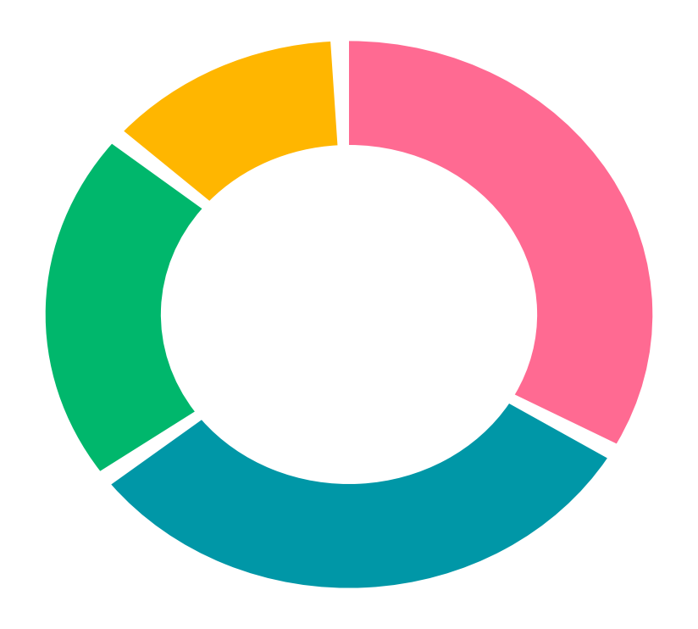
Mood Cluster Composition (K=4)
Hype
34%
Sunny
21%
34%
21%
Highest energy, highest valence
Low energy, high valence
Total: 28,356 tracks
Mellow
13%
Dark
32%
Low energy, low valence, high acousticness
Highest energy, lowest valence
13%
32%
K-Means on the 7 mood-DNA features, validated against real tracks. See notebook for full breakdown

Slide 13
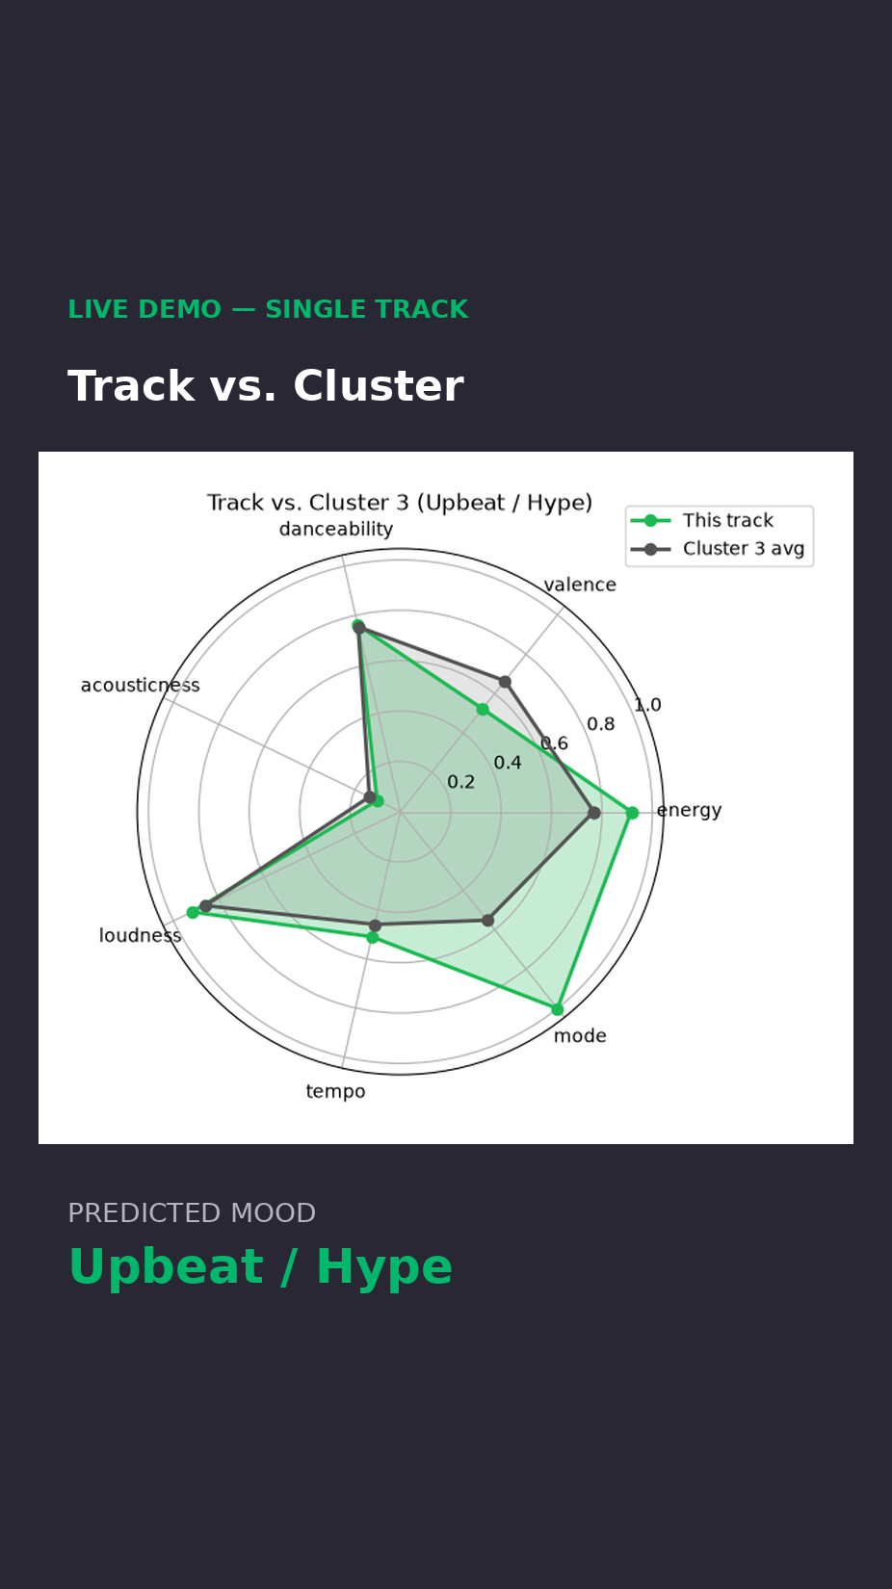
Here’s the live demo
Compares the track’s audio profile against its cluster average — closer shapes mean a stronger mood match.

Slide 14
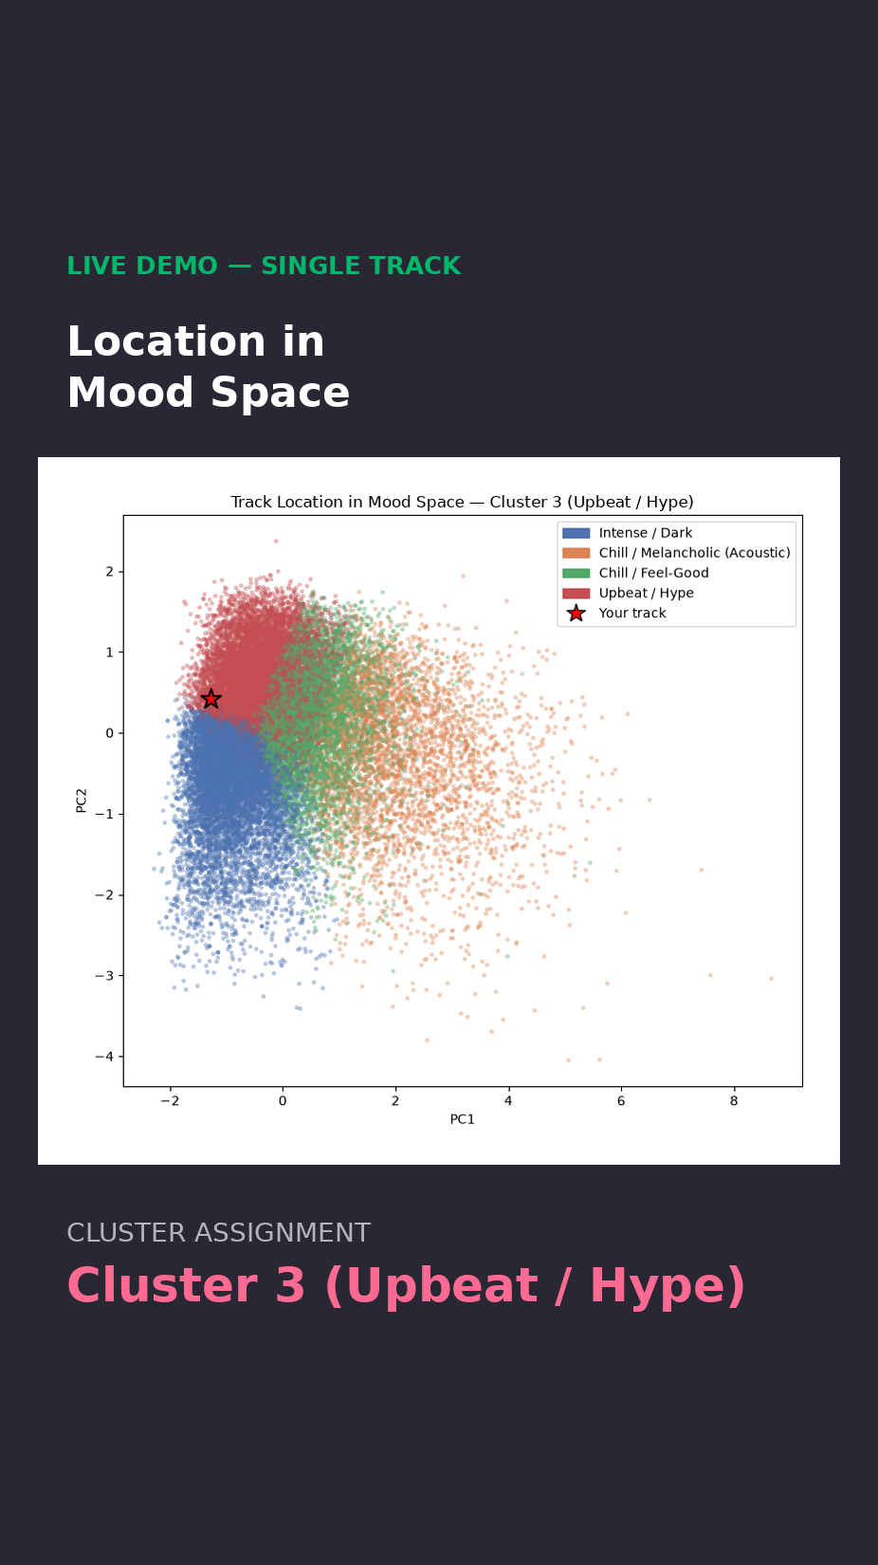
Here’s the live demo
The same track in 2D — it sits right on the boundary between Upbeat/Hype and Intense/Dark.

Slide 15
Mood-Matched Playlist (Cluster 3)
# | Track |  | Artist | Mood | Distance
1 |  | Do It Again | Steve Aoki | Upbeat / Hype | 0.324
2 |  | Lettin Go! | Janelle Monáe | Upbeat / Hype | 0.328
3 |  | Blah Blah Blah | Kesha | Upbeat / Hype | 0.351
4 |  | You Got That | Loud About Us | Upbeat / Hype | 0.362
5 |  | Where Is the Love | Alex Martura | Upbeat / Hype | 0.392
6 |  | As If It’s Your Last | BLACKPINK | Upbeat / Hype | 0.393
7 |  | Don’t Stop | Curbi | Upbeat / Hype | 0.418

Slide 16
Progress: Challenges & Next Steps
Bug Fix
Fixed
Pick K
Resolved
Fixed thresholds collapsed 3/4 clusters into one label
K=2 was statistically better but too coarse — chose K=4
Export
Next
Backend
Next
Export the scaler, K-Means model, and PCA as .joblib
Wrap the pipeline in a class for a Streamlit/Gradio demo

Slide 17

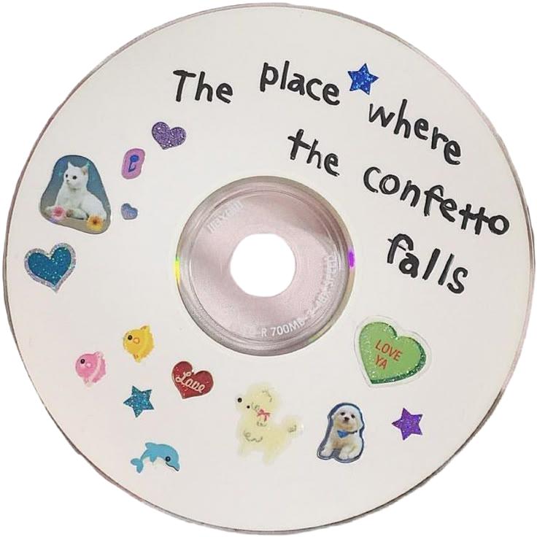
Thanks!
Spotify Mood Clustering
Search
Home
Library

